Slide 1


Hotel Sentiment Analyzer
NLP-Based Hotel Review Sentiment Analysis
Group Members:
R. Varshith Rao - AP23110010395
CH. SriRam - AP23110010379
G. Sanjana - AP23110011357
K. Aneesh - AP23110010394
D. Sandeep - AP23110010400

Slide 2

Introduction
Hospitality industry relies heavily on customer feedback
Online reviews contain valuable insights about guest experiences
Manual review analysis is time-consuming and inefficient
Objective: Automatically analyze and categorize hotel reviews into positive, negative, or neutral sentiments

Slide 3

Problem Statement
Hotels receive hundreds or thousands of reviews daily
Manual sentiment analysis is tedious and inefficient
Lack of structured insights affects decision-making
Need: Automated system for sentiment detection and visual reporting

Slide 4






Project Objectives
Web-based Platform
Interactive Data Visualization
Web-based platform for sentiment analysis
Interactive charts for sentiment distribution
Review Analysis Capabilities
Reporting and History
Single review & batch review analysis capabilities
Downloadable reports & analysis history
Sentiment Classification
Secure Access Control
Classify reviews as positive, negative, or neutral
Secure, role-based access control

Slide 5
Tools & Technologies
Front-end
Back-end
HTML, CSS, Bootstrap
Python, Flask
JavaScript
REST APIs
Database
Libraries
SQLite / MySQL
Flask-SQLAlchemy, Flask-Login
pandas, NumPy
NLTK, TextBlob
matplotlib, seaborn

Slide 6





System Architecture
User Interface
Login, signup, dashboard, review input
Back-End Processing
Flask handles requests and communicates with database
Sentiment Analysis Module
NLP techniques using TextBlob and NLTK
Computes polarity & subjectivity
Database
Stores users, reviews, and analysis results
Visualization
Interactive charts for sentiment distribution and top aspects

Slide 7






Key Features
User Management
Review Analysis
Login, Signup, Role-Based Access
Single and batch analysis
Sentiment Detection
Visual Reports
Positive, Negative, Neutral classification
Bar charts, Pie charts, Aspect analysis
Downloadable Reports
Additional Features
Export as CSV/PDF
Saved Analysis History, Delete Review Option

Slide 8





Workflow
User logs in
Dashboard
Enter single or multiple reviews
NLP processes reviews
predicts sentiment & polarity
Generate charts
(Bar, Pie, Top Aspects)
Store results
in database

Slide 9
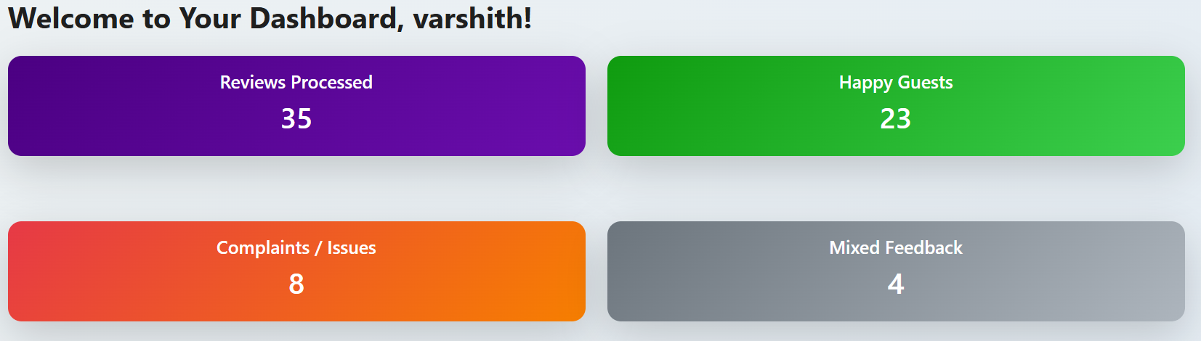
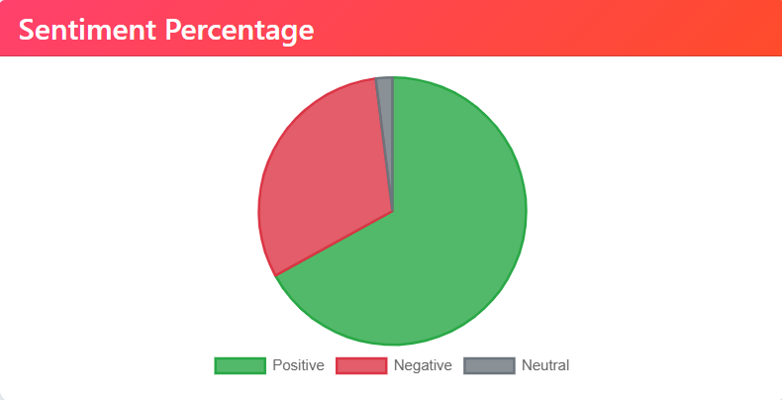
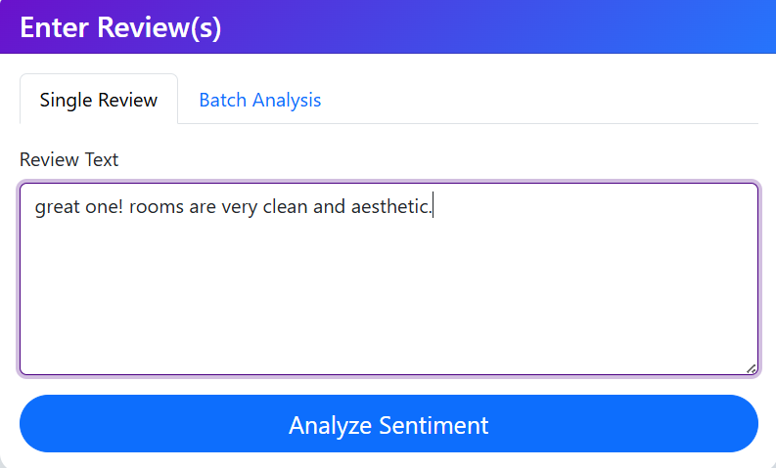
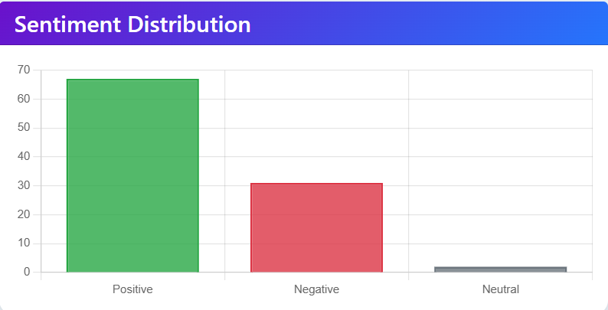
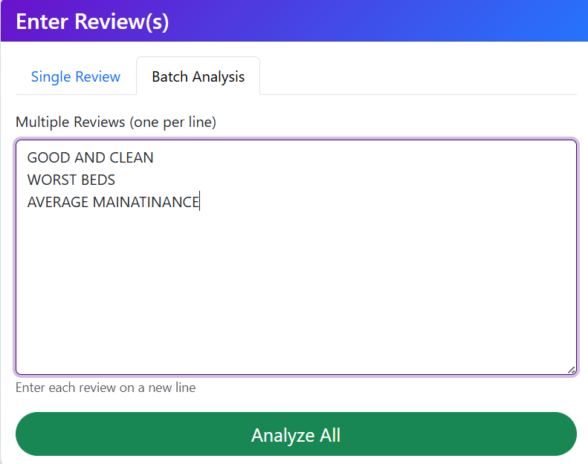
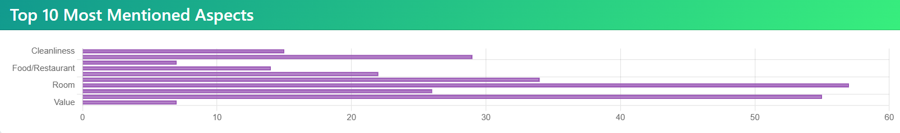
Demo Screenshots
Dashboard with statistics cards
Charts for sentiment distribution
Single review analysis interface
Batch review analysis interface
Top aspects chart

Slide 10




Charts & Visual Reports
Bar Charts
Pie Charts
Display number of positive, negative, and neutral reviews
Show sentiment distribution percentages
Visual representation of overall sentiment
Easy comparison of sentiment distribution
Top Aspects Analysis
Features
Service quality
Interactive & dynamic visualizations
Room quality
Auto-updated after each analysis
Amenities

Slide 11





Challenges Faced
Efficient batch processing for large datasets
Handling neutral and mixed reviews accurately
Creating responsive & user-friendly web interface
Maintaining secure login & role-based access
Displaying clean, interactive charts

Slide 12





Future Enhancements
Integrate ML models for improved accuracy
Multi-language review support
Real-time sentiment tracking for hotel dashboards
Admin dashboard for managing users & reviews
Deploy on cloud platforms for global access

Slide 13
Conclusion
Key Takeaways:
✓ Simplifies hotel review processing
✓ Provides actionable insights for decision-making
✓ Saves time & effort significantly
✓ Interactive visuals aid in understanding trends
✓ Scalable & extendable for future improvements
Impact:
Automated sentiment analysis transforms how hotels understand and respond to customer feedback.

Slide 14

Thank You
"Thank you for your attention!"

